Slide 1

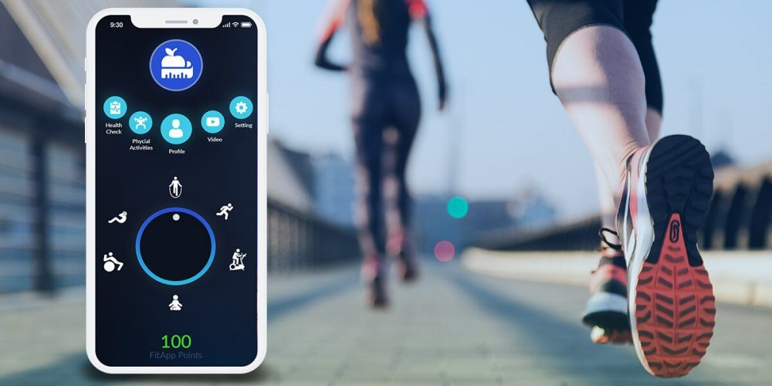
Personalized Fitness Plan Recommender

Slide 2
WHAT IS RECOMMENDER SYSTEM
A recommender system is a type of software that suggests items to users based on their interests, behavior, or preferences. You’ve probably seen them in action whenever a platform like Netflix suggests movies, Spotify recommends songs, or Amazon proposes products you might like. They work by analyzing data on what you like, what you've done before, or even what similar users are interested in, making your experience more personalized and helping you discover new things.
Recommendation systems are generally divided into several types, each designed to make suggestions in different ways based on how they analyze user data and item features. Here’s a look at the main types
Content-Based Filtering
Collaborative Filtering

Slide 3
Types of Recommendation systems
Content-Based Filtering:
In content-based filtering, the recommendation system uses characteristics of items to suggest other items that are similar. It relies on a user’s history and known item attributes.
How it Works:
It examines the content or features of items (e.g., genre, author, or keywords for books/movies) and finds similarities between items. Then it compares this with what the user has liked or interacted with before.
Example:
If a user watches several sci-fi movies, the system may recommend other sci-fi movies, as it has learned the user's preference for that genre

Slide 4
Collaborative Filtering:
Collaborative filtering makes recommendations based on user interactions, without relying on item features. It assumes that users with similar preferences will like similar items.
How it Works: Collaborative filtering analyzes past interactions of users to find patterns. It can work in two main ways:
  User-Based: Finds users similar to the target user and recommends items they have liked.
  Item-Based: Finds items that are similar based on how users have rated or interacted with them.
Example:
If two users have watched and rated similar movies highly, the system might recommend to one user a movie that the other has watched but they haven't.

Slide 5
What is Personalized Fitness Plan Recommender System
A Personalized Fitness Plan Recommender System is an advanced, data-driven tool designed to create customized fitness and wellness plans tailored to individual users. By analyzing information such as age, weight, fitness level, health conditions, exercise preferences, and personal goals (e.g., weight loss, muscle gain, or endurance), the system delivers personalized recommendations. These suggestions often include specific workout routines and nutritional guidance, enhancing users' ability to achieve their fitness goals effectively.
The system leverages user profile analysis to build a unique fitness profile for each user, ensuring recommendations are aligned with their physical needs and preferences. It also includes a database of exercise and activity options categorized by type (e.g., cardio, strength training, flexibility), intensity level, and required equipment. Using sophisticated recommendation algorithms—such as content-based filtering and collaborative filtering—the system can provide highly relevant workouts, meal plans, and lifestyle suggestions.

Slide 6
How It Works?
  User Profile Creation: Gathers user data (age, fitness level, goals) to build a personalized profile.
  Exercise and Diet Database: Pulls from a library of exercises and meal plans suited to various needs.
  Recommendation Algorithms: Uses advanced algorithms (Content-Based, Collaborative Filtering) to suggest workouts and meals.
  Progress Tracking: Continuously adapts to the user’s improvements and feedback for a dynamic experience.

Slide 7
Applications:
Fitness Apps: Tailors workout and nutrition plans to user goals.
Health and Wellness Platforms: Provides holistic, personalized health solutions.
Gyms and Fitness Centers: Delivers customized training plans for members.
Corporate Wellness Programs: Promotes employee wellness through personalized plans.
Wearable Device Integration: Uses wearable data to adjust fitness recommendations.
Physical Therapy and Rehabilitation: Creates safe, individualized recovery plans.
Sports Training Programs: Customizes training for athletes to enhance performance.

